Slide 1
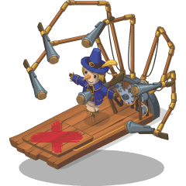
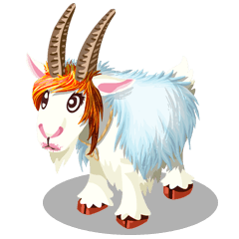
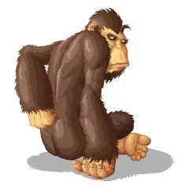
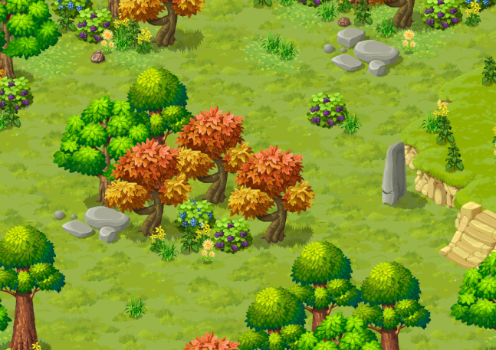
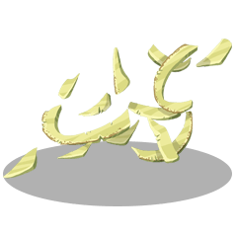
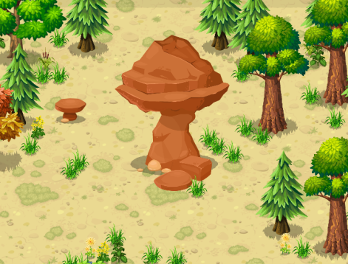
Yan Cui @theburningmonk
Catching BIGFOOT

Slide 2
WHO AM I?
Notes:
Before I start, let me quickly tell you a bit more about myself.
I work for a company called Gamesys, we're based in Piccadilly Circus and are one of the market leaders in the real-money gaming business.
Me and my team focus on freemium games for a more social audience and as a backend developer, I have built the backend for a number of our social games on Facebook and mobile.
Across our social games, we have around 1 million Daily Active Users and, 250 millions requests per day.
Pretty much every user action in our games are recorded and analyzed, we capture around 2TB of data a month for analytics purpose alone.

Slide 3

Notes:
Before I start, let me quickly tell you a bit more about myself.
I work for a company called Gamesys, we're based in Piccadilly Circus and are one of the market leaders in the real-money gaming business.
Me and my team focus on freemium games for a more social audience and as a backend developer, I have built the backend for a number of our social games on Facebook and mobile.
Across our social games, we have around 1 million Daily Active Users and, 250 millions requests per day.
Pretty much every user action in our games are recorded and analyzed, we capture around 2TB of data a month for analytics purpose alone.

Slide 4
1M
DAILY
ACTIVE
USERS
ILLION

Slide 5
250
REQUEST
PER
MILLION
DAY

Slide 6
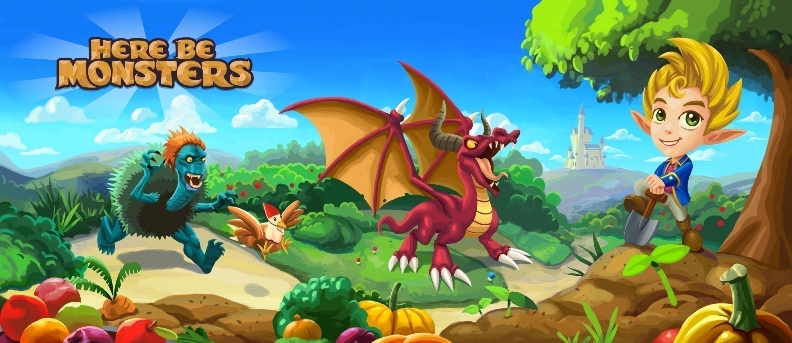
Notes:
For today, I'm gonna talk about one of our games in particular, Here Be Monsters.

Slide 7
location
Notes:
It's a location-based game where everything's happening in a world that's similar to medieval Earth,
except that all the monsters from local forklores and legends are real and they live in harmony with the elf-like natives.
That is, until the mysterious stariums started to fall from the sky and drive the monsters crazy, and your job as the hero is, in part, to catch these monsters and cure them of the madness.
There are lots of places for you to visit in the game, over 500 in fact,
each are named after real-world towns or cities.
On each continent there is also a town, where you can find lots of shops and NPCs, as well as other players just chilling out in towns.

Slide 8
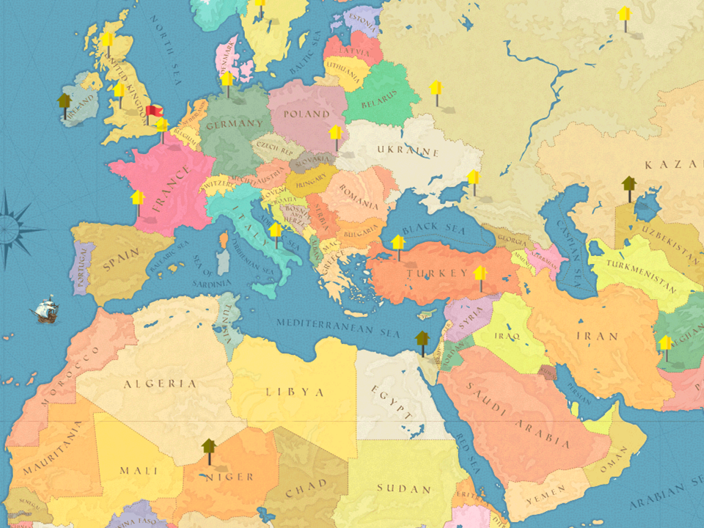

Slide 9
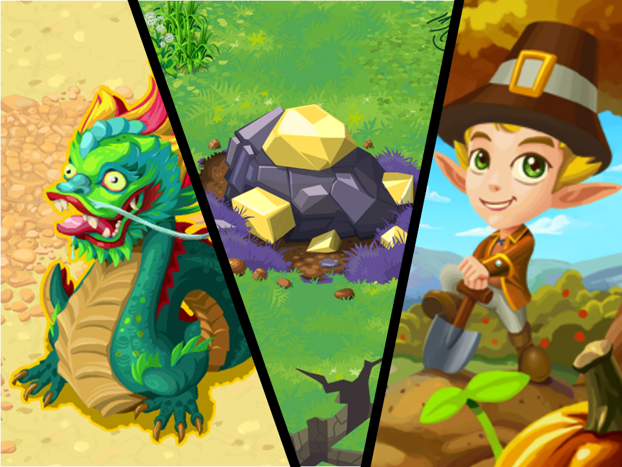

Slide 10
Starium

Slide 11
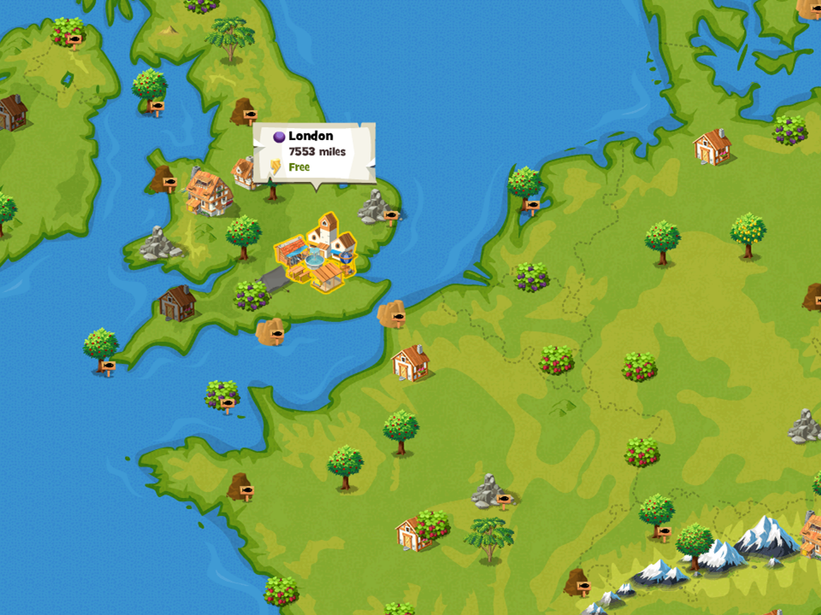
500 Spots

Slide 12
location
episodic
Notes:
It's an episodic, story-driven game.
The storyline is broken up into seasons and episodes,
season 1 started in London and took the player all over Europe, to Germany, Spain and Italy to name a few.
Season 2 then took the player to the mysterious land of the East, to China and Japan,
and as we approach the season 2 finale in the coming weeks, a sequence of events will soon unfold and take the players to a brand new continent.

Slide 13
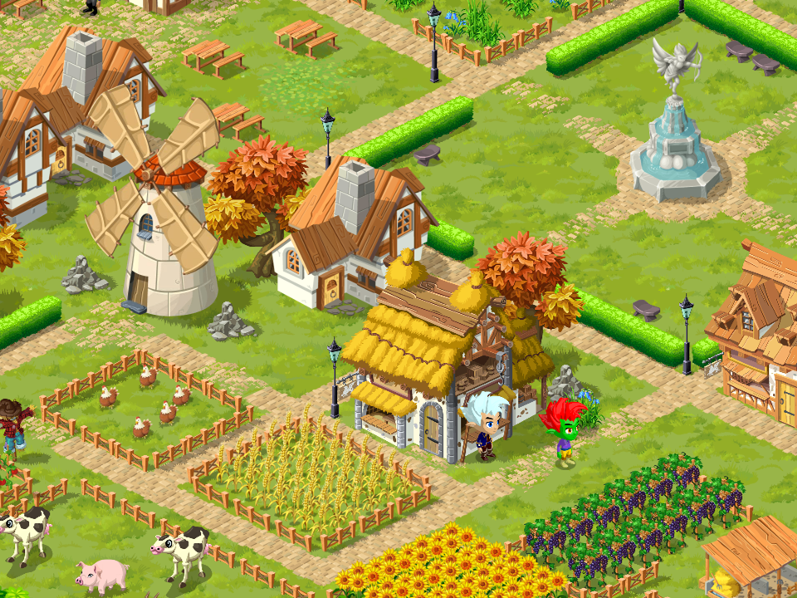
LONDON
2012

Slide 14
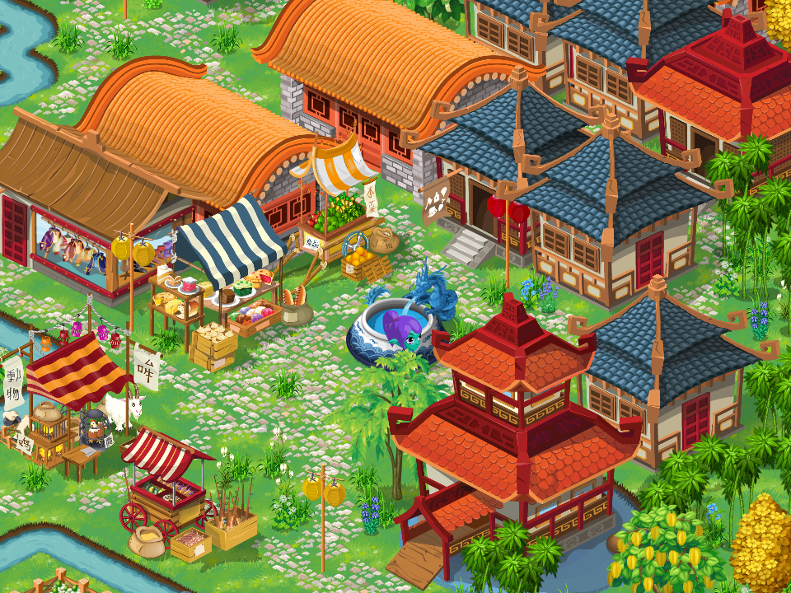
NANJING
2013

Slide 15
?
2014

Slide 16
location
episodic
multi-player
Notes:
It's a multi-player game, and nowadays pretty much anywhere you go you'll find other players who are there to do the same quest as you are.
There's a global chat system where you can go and ask for help if you're stuck on a quest and dunno what to do.
You can also ask players you encounter to be your in-game buddies and help each other out with gifts, etc.,
but we never block you from playing and force you to spam your Facebook friends!
Right now, we have players on a number of different platforms and the game is localised in English and Brazilian Portugese, with other languages and platforms coming soon.

Slide 17



iPad
buddies
herebemonstersgame.com

Slide 18
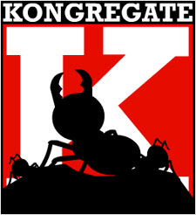

iPad
buddies
herebemonstersgame.com

Slide 19
location
episodic
multi-player
RPG
Notes:
Lastly, it's a role-playing-game and has many of the same game-play elements you are probably familiar with from other RPGs.
As you travel around the world you'll encounter NPC and find items, and the things you find and those you grow at home can be combined together to make more interesting items.
We have spent a lot of time and effort researching and making sure that things you find in the game are exactly where they should be, and one of the constant piece of feedback we get is that people find it educational as well as fun to play.
We often hear from players that they have learnt about places and butterflies that they have never known before,
I mean, who would have thought that there's a butterfly called "Question Mark"! I raised it as a bug the first I saw it, but turns it was real and it's a common butterfly in North America.
The NPCs you encounter will give you quests, of which there are plenty, and these quests push you along in the storyline.
Monster trapping is a big part of the game, and to catch them you need to be at the right place, using the right combination of trap and bait. There are more than 100 monsters in the game right now and more are added every couple of weeks.
Besides all the things you can do in the game, you also have a homestead you can tend to, and there are plenty of ways for you to make use of those creative energy of yours!

Slide 20
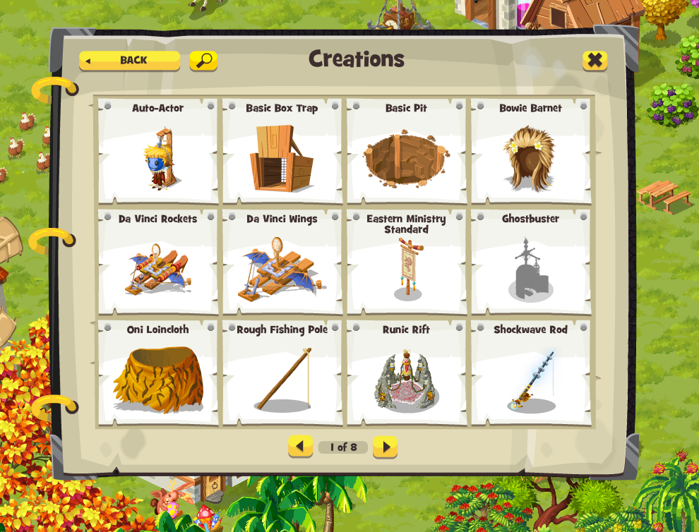
3500
items

Slide 21
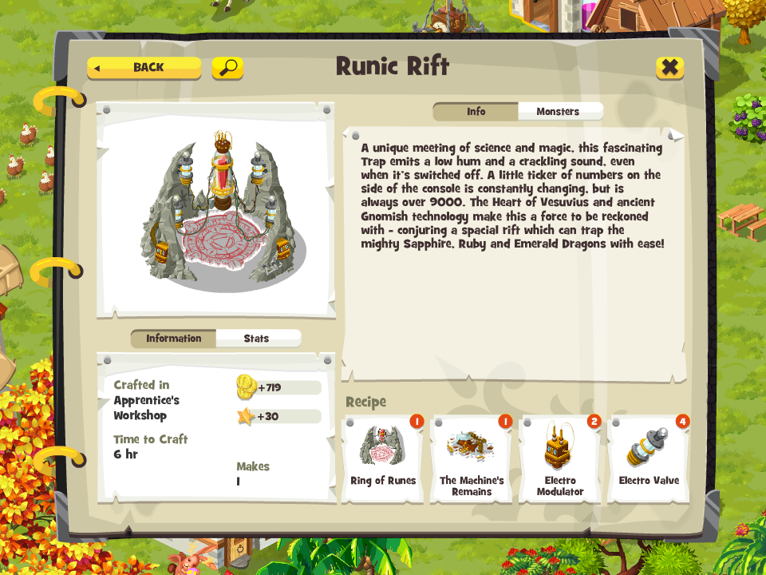
700
recipes

Slide 22
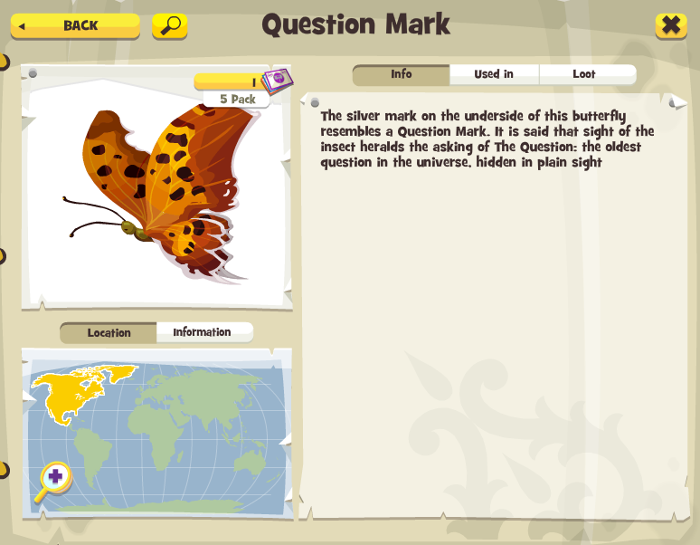

Slide 23
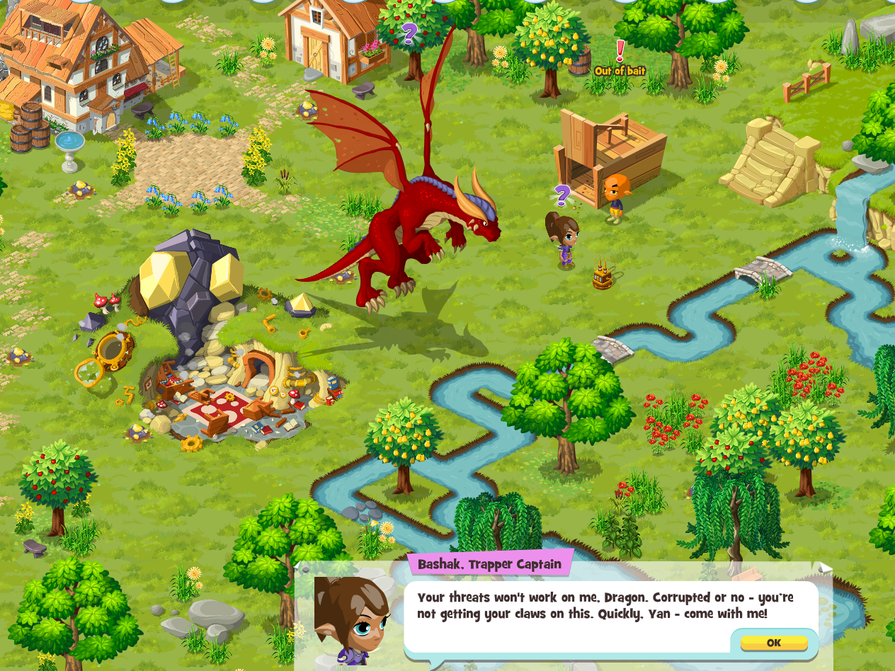
1500
quests

Slide 24
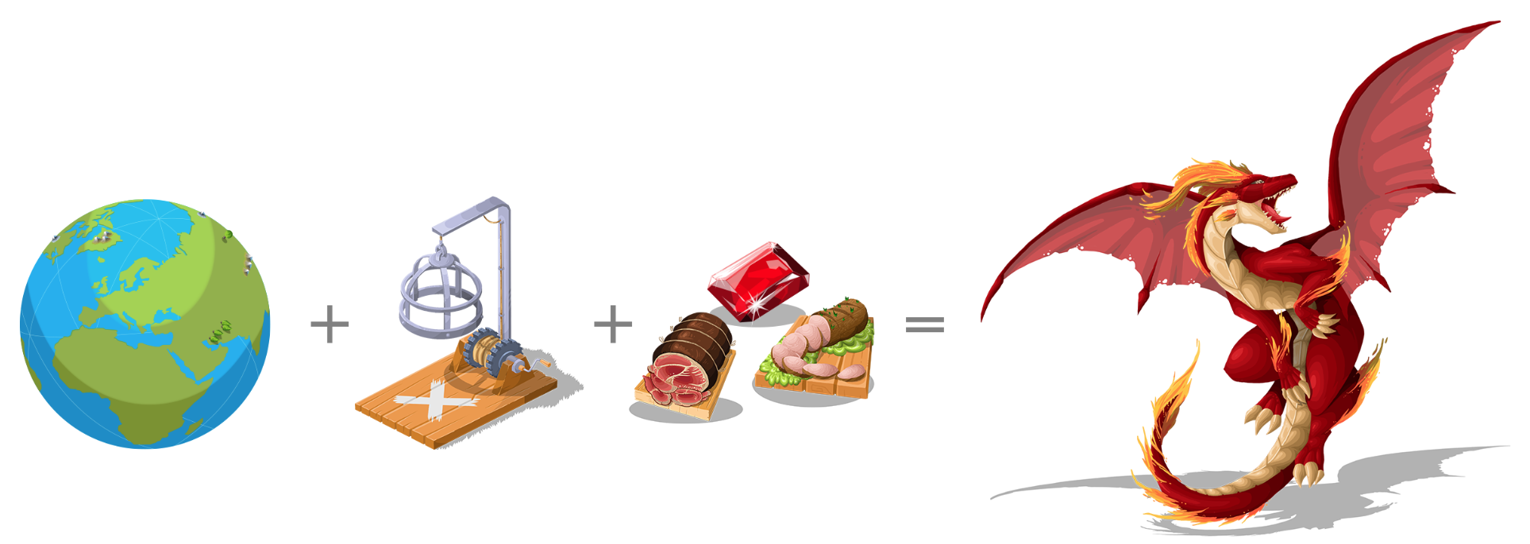


Slide 25
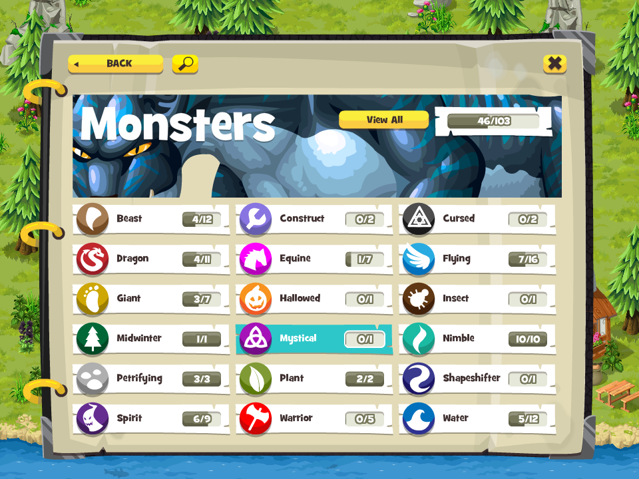

Slide 26
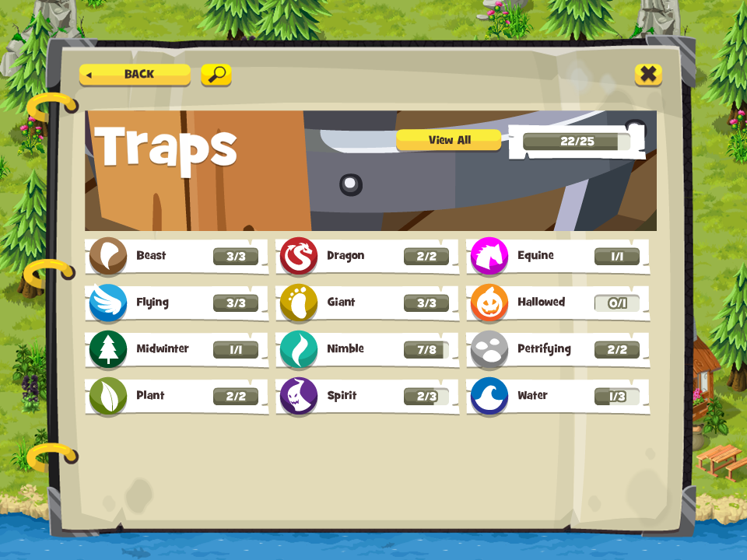

Slide 27
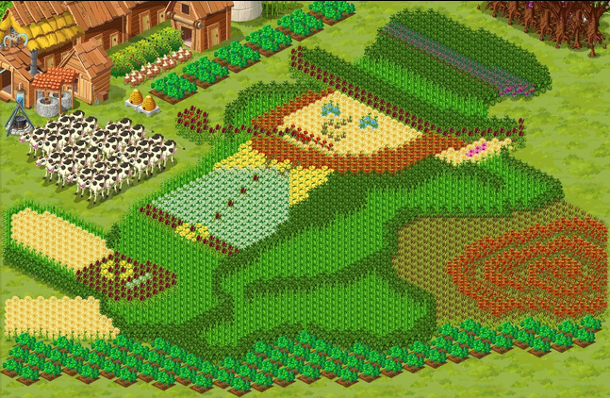

Slide 28
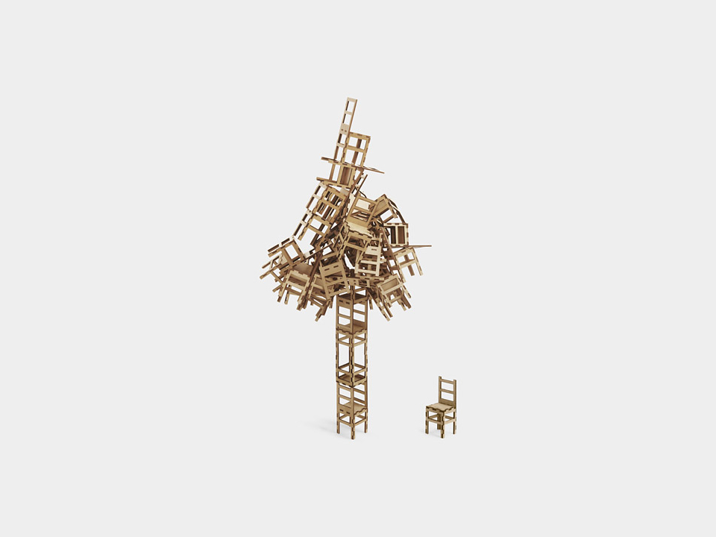
game
balancing
Notes:
One of the main challenges that we face, and many others like us, is to making sure that the game is well balanced in terms of its content.
There are many aspects to this, one of which is the in-game economy.
Take an entry-level camouflage trap for instance, which is one of the very first traps you'll make, it's made from the a basic box trap, a bucket of camouflage paint, and an oak tree.
The camouflage paint itself is made from a number of different coloured paints, and so on.
So if you raise the price of basic ingredients like water, that increase needs to bubble all the way up the ladder.
When you look at how many items are made from water, and how many more items that are made from those items, there's a huge knock-on effect.
Failures to address this knock-on effect will create arbitrage opportunities and can unbalance the economy,
players will be able to easily make money from buying and selling items and will less need to make real-money purchases with us.
This is just the tip of the iceberg.

Slide 29
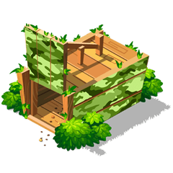

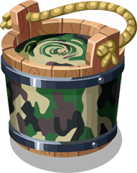






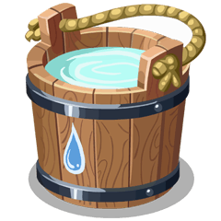
item
Pricing

Slide 30

item
Pricing

Slide 31
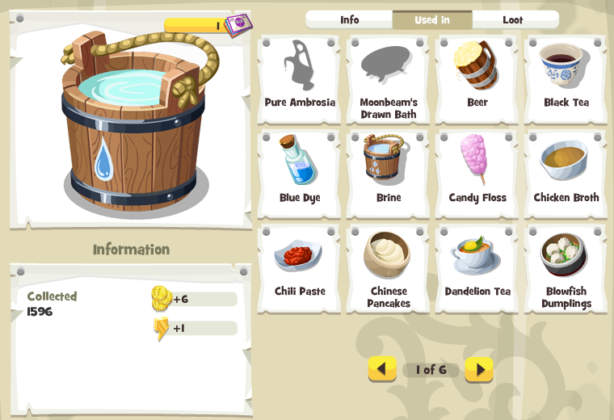
item
Pricing

Slide 32
item
Pricing

Slide 33

Notes:
In general, balancing a game like this by hand is slow, it's repetitive and worst of all, it's error-prone and the results are highly subjective - what feels right to one person can be completely off for another.
Others have attempted to solve this problem by simply throwing bodies and man hours at it, but for us, with a very small team behind the project,
we want to work smarter and more efficiently and find an approach that allows to stay agile and be able to iterate and produce new contents quickly.
What we needed was a more scientific and systematic approach.
And that's where Neo4j comes in.

Slide 34
Manual game balancing is SLOW

Slide 35
It is REPETITIVE

Slide 36
and worst of all...

Slide 37
It is ERROR-PRONE
and SUBJECTIVE

Slide 38
there must be a better way...

Slide 39
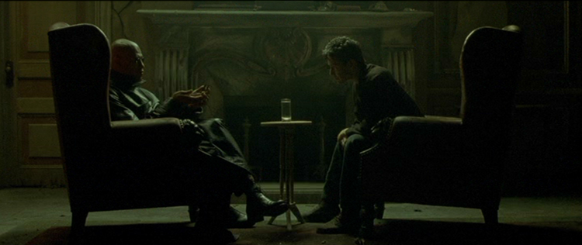

Hello, Neo4j
The rabbit hole sounds pretty good right about now!

Slide 40
catching
BIGFOOT
Notes:
If we take Bigfoot as an example, if you visit his almanac page in the game, a sort-of in-game wikipedia,
you can see where in the world you can find him, what bait he likes and your likelihood of being to attract him with the bait.
You can also see what lootdrops he gives and what traps you need to use to catch him.
And to represent all the data you see in this screen as a graph you'll get something like this..
And if you extend the graph to include other related nodes, you start to bring other monsters and traps into the view.

Slide 41
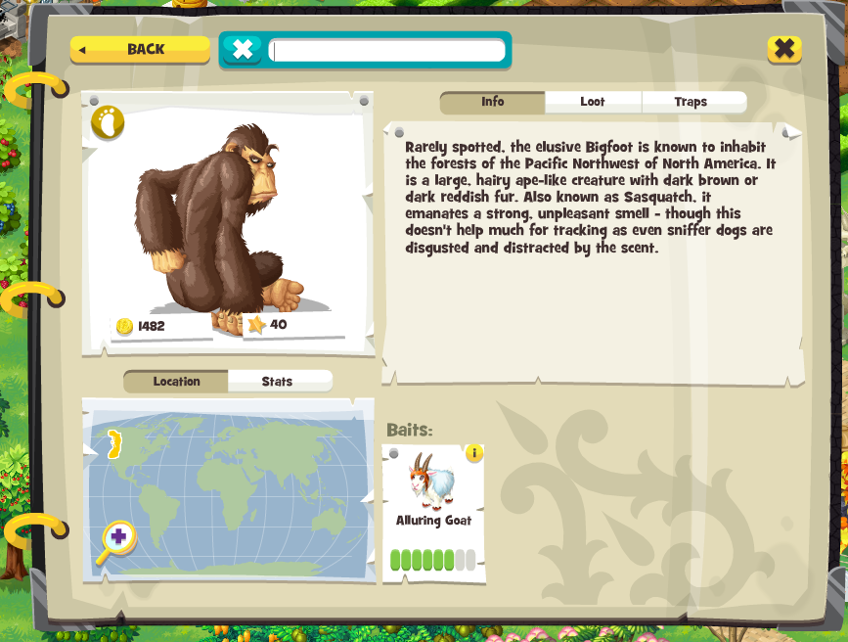
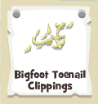
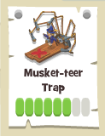
catch rate
location
bait
attraction rate

Slide 42
as a graph in Neo4j

Slide 43
Bigfoot Toenail Clippings
loots
Musket-teer Trap
can_catch
Alice Lake
exists_in
Bigfoot
exists_in
can_attract
Alluring Goat
Omar Lake

Slide 44
Bigfoot Toenail Clippings
loots
Yowie
Alice Lake
Musket-teer Trap
can_catch
Bigfoot
can_catch
can_catch
Yeti
exists_in
Omar Lake
exists_in
Apprentice’s Workshop
can_attract
Alluring Goat
loots
London
Yeti Fur
McDonald’s Farm
makes
can_make
exists_in
requires
Goat
Beeswax
sells
Alluring Goat Recipe
Honey
loots
Goat’s Milk
requires
harvests
requires
harvests
Bee Hive
loots
requires
Peryton Fawn Decoy Recipe
Peryton Fawn Decoy
makes
Notes:
From here, you can see that the Musket-teer trap can catch the Bigfoot, as well as Yowie and Yeti.
To make the bait for Bigfoot you need to craft it at your Apprentice's Workshop, by combining a Goat, some honey and a piece of Yeti fur.
You can buy the goat from McDonald's Farm in london, you can harvest honey by building a Bee Hive. But to get some Yeti Fur, you need to first catch Yeti using the Musket-teer trap.
And the cycle continues.
In fact, if you go all the way back, this is what the game looks like, whilst the avg degree of connectedness is only 5, there are many outliers with hundreds of connections in and out-of the nodes.
So now that we've modelled the game as a graph, let's see how we can use it to help us automate the balancing process.

Slide 45
Bigfoot Toenail Clippings
loots
Yowie
Alice Lake
Musket-teer Trap
can_catch
Bigfoot
can_catch
can_catch
Yeti
exists_in
Omar Lake
exists_in
Apprentice’s Workshop
can_attract
Alluring Goat
loots
London
Yeti Fur
McDonald’s Farm
makes
can_make
exists_in
requires
Goat
Beeswax
sells
Alluring Goat Recipe
Honey
loots
Goat’s Milk
requires
harvests
requires
harvests
Bee Hive
loots
requires
Peryton Fawn Decoy Recipe
Peryton Fawn Decoy
makes

Slide 46
Bigfoot Toenail Clippings
loots
Yowie
Alice Lake
Musket-teer Trap
can_catch
Bigfoot
can_catch
can_catch
Yeti
exists_in
Omar Lake
exists_in
Apprentice’s Workshop
can_attract
Alluring Goat
loots
London
Yeti Fur
McDonald’s Farm
makes
can_make
exists_in
requires
Goat
Beeswax
sells
Alluring Goat Recipe
Honey
loots
Goat’s Milk
requires
harvests
requires
harvests
Bee Hive
loots
requires
Peryton Fawn Decoy Recipe
Peryton Fawn Decoy
makes

Slide 47
Bigfoot Toenail Clippings
loots
Yowie
Alice Lake
Musket-teer Trap
can_catch
Bigfoot
can_catch
can_catch
Yeti
exists_in
Omar Lake
exists_in
Apprentice’s Workshop
can_attract
Alluring Goat
loots
London
Yeti Fur
McDonald’s Farm
makes
can_make
exists_in
requires
Goat
Beeswax
sells
Alluring Goat Recipe
Honey
loots
Goat’s Milk
requires
harvests
requires
harvests
Bee Hive
loots
requires
Peryton Fawn Decoy Recipe
Peryton Fawn Decoy
makes

Slide 48
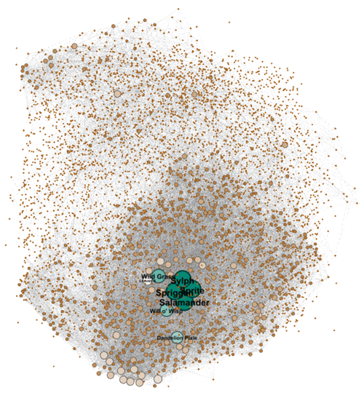
~ 7000 nodes
~ 35000 edges
avg 5 degrees of connectedness

Slide 49
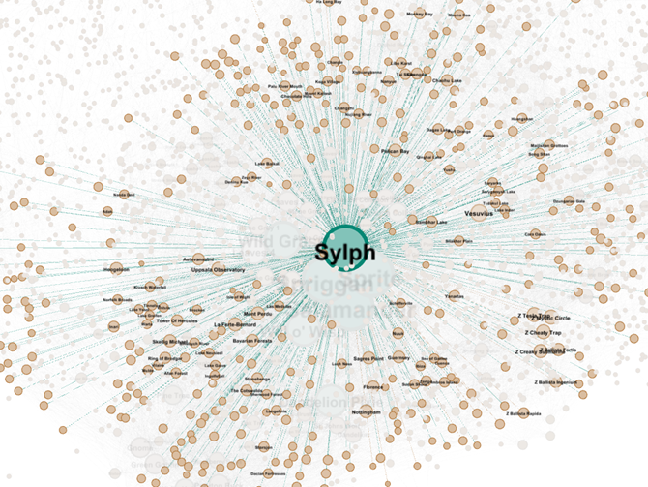

Slide 50
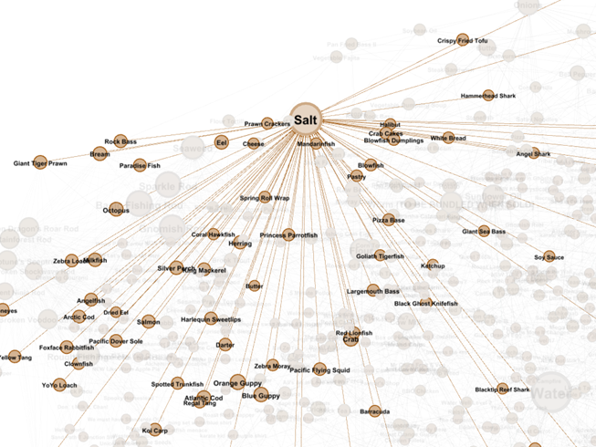

Slide 51
game
balancing
(revisited)

Slide 52
IMPACT ANALYSIS
Notes:
From the item pricing example earlier, the key challenge is to be able to understand the impact of change.
Take the White Bread for example, to work out the blast radius of a price change, let's first look at the relationships between an ITEM and a RECIPE.
An item IS USED IN a recipe, and a recipe CRAFTS an item.
To find all the items that are made from White Bread, we can write the following, which looks for any item which are connected to the White Bread through at least one instance of either IS_USED_IN or CRAFTS relationship.

Slide 53
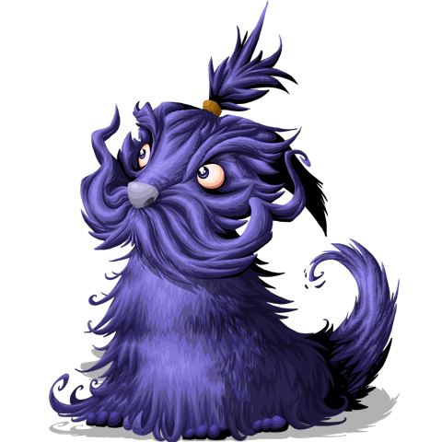
What’s the impact of upping the price of “White Bread”?

Slide 54
ITEM
RECIPE
ITEM
IS_USED_IN
CRAFTS
Notes:
From the item pricing example earlier, the key challenge is to be able to understand the impact of change.
Take the White Bread for example, to work out the blast radius of a price change, let's first look at the relationships between an ITEM and a RECIPE.
An item IS USED IN a recipe, and a recipe CRAFTS an item.
To find all the items that are made from White Bread, we can write the following, which looks for any item which are connected to the White Bread through at least one instance of either IS_USED_IN or CRAFTS relationship.

Slide 55
MATCH (wb:BaseMarketplaceItem { Name:"White Bread"})
-[rel:CRAFTS|IS_USED_IN*1..]
->(i:BaseMarketplaceItem)
RETURN i, rel, wb

Slide 56
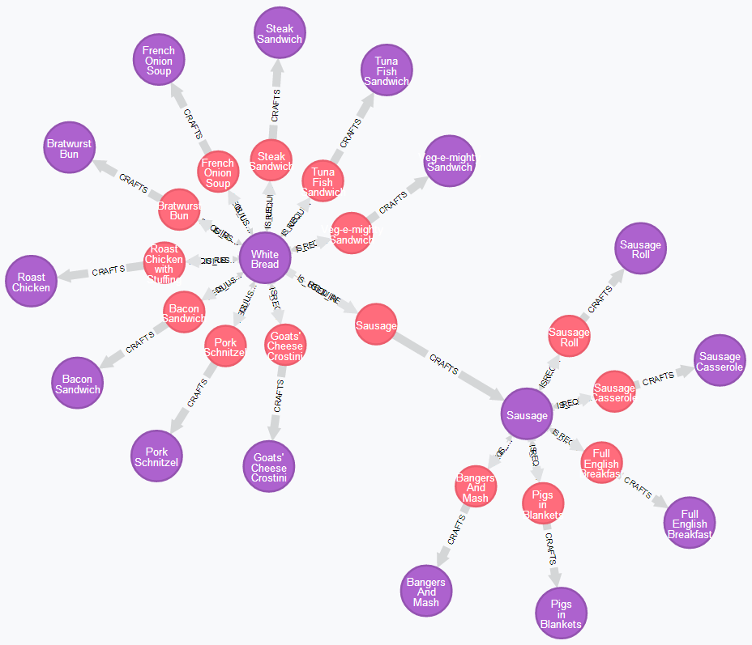
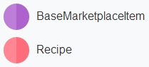

Slide 57
SCARCITY ANALYSIS
Notes:
Not all items can be priced as derivatives of others, and some need to be priced manually, based on their scarcity in the world, like the fruits that you can forage from fruit trees you find as you travel.
So the next question we want to answer is that, based on the following relationship - that fruits are foraged from fruit trees, which exist in spots - how scarcely available are durians and dragonfruit, both are exotic fruits that are found only in warmer climates.
From the result of this simple query, you can see that Durian is much harder to come by compared to dragon fruit, so naturally it should be made more expensive than dragon fruit.
You can also see in the almanac pages for these fruits where they are available in the world, and the EXISTS_IN relationship also contains the count of fruit trees in that spot,
and the pricing model also takes into account other factors such as how many pieces of fruit you get from one forage action from a fruit tree.

Slide 58
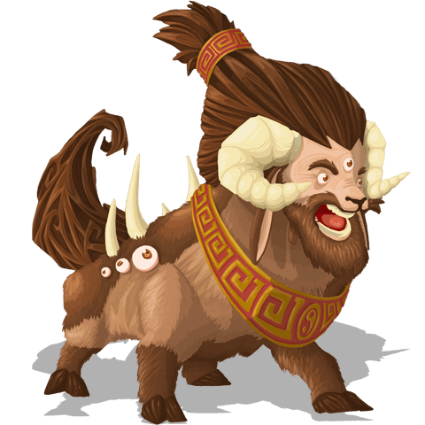
How scarce is “Durian” compared to “Dragonfruit”?

Slide 59
FRUIT
FRUIT TREE
SPOT
FORAGES
EXISTS_IN

Slide 60
MATCH (fruit)<-[:FORAGES]-(tree)-[:EXISTS_IN]->(spot)
WHERE fruit.Name=‘Durian’ OR fruit.Name=‘Dragonfruit’
RETURN fruit, tree, spot

Slide 61
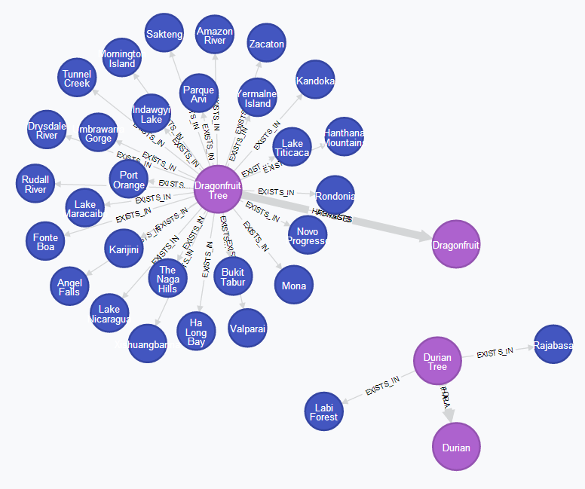
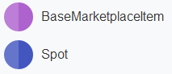

Slide 62
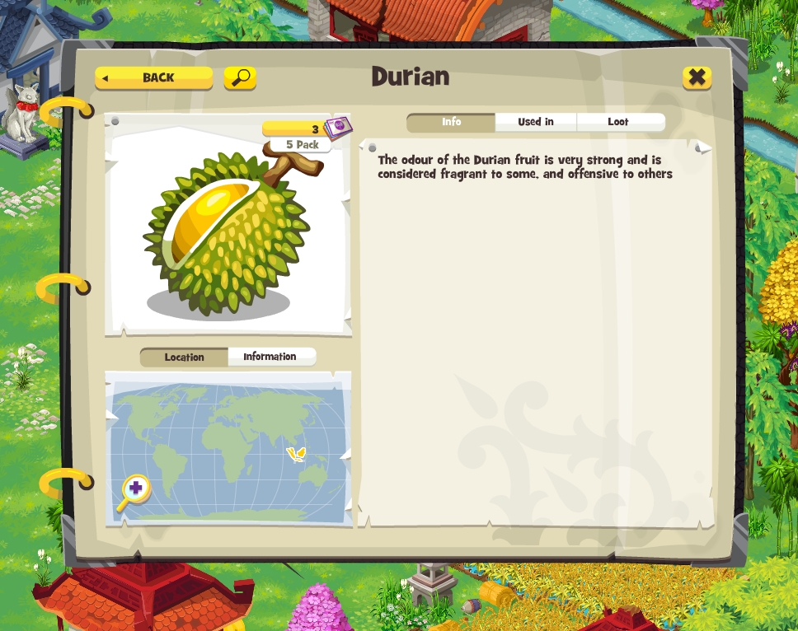

Slide 63
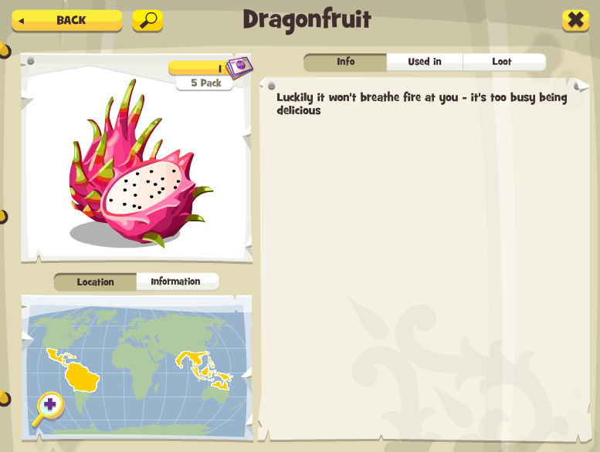

Slide 64
QUEST LINES
Notes:
To look at the quests and understand how they relate to items - some quests require items to complete, and they sometimes award items when you complete them.
Completing a quest can unlock a follow-up quest in the chain as well.
To find out what quests are unlocked after the completion of a particular quest, it's super easy.
Again, if you go all the way back out, and look at how all the quests tie together it looks like this, and somewhere in this ball of tweed there is a single thread which takes you from the very first quest to the latest in the game.
But just being able to visualize how quests tie together is not all that interesting. One idea we experiment with, and haven't perfected, is to use the items that quests require to give us an indication as to the difficulty of that quest.

Slide 65
ITEM
QUEST
ITEM
REQUIRES
AWARDS
UNLOCKS
QUEST

Slide 66
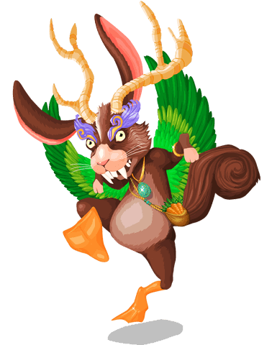
What quests come after “Year of the Horse”?

Slide 67
MATCH (q1:Quest { Name: “Year of the Horse” })
-[:UNLOCKS]->(q2:Quest)
RETURN q1, q2

Slide 68
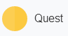
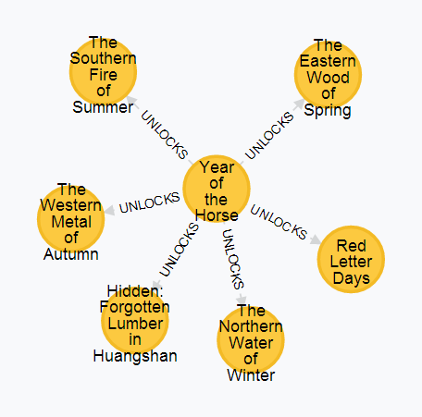

Slide 69
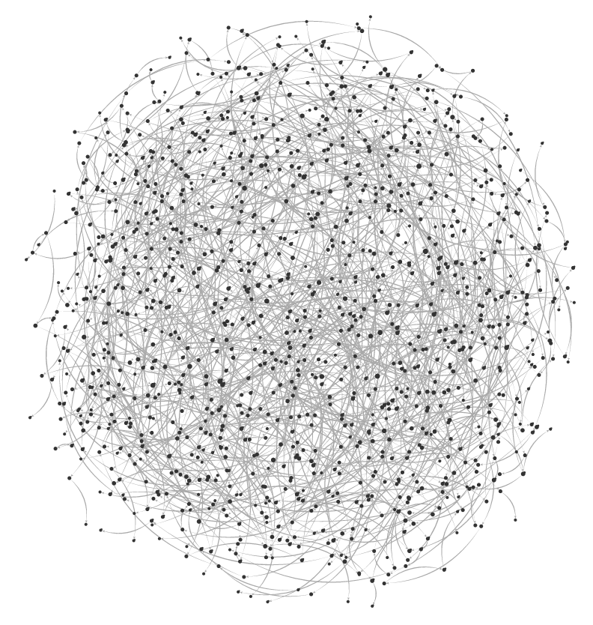

Slide 70
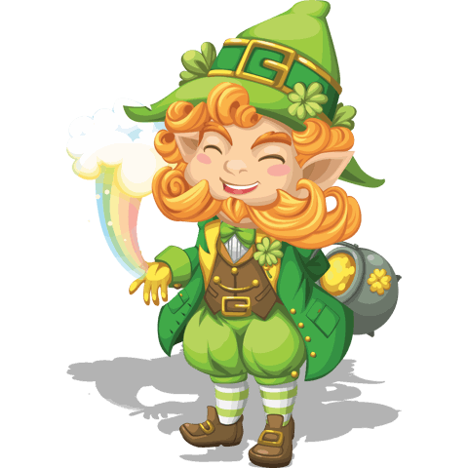
How would you model quest progression?
Notes:
And by understanding the difficulty posted by each quest we can then make sure that there is a smooth progression through the quest line
so that we don't lose players who become disinterested as they struggle to complete quests that are outside their abilities.
And that's one area that WOW really excels in, and you're never asked to do something that you clearly are not ready to.
With the pricing model in full motion, we can price baseline items based on factors like rarity, and calculate the price for items that derive from them,
so the price of an item should also be a reflection of how difficult it is to obtain that item.
Once you've done the hard work to price the items, you can use the output of that to enrich your original model in Neo4j and
you can then price the quests in a similar way based on the items that they require.
Cheaper quests should come before more expensive ones, and they should award less valuable items as reward too.

Slide 71
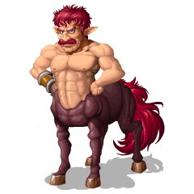
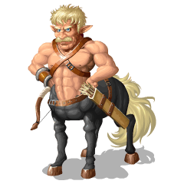
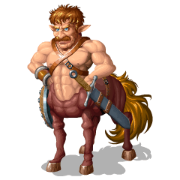
2. Enrich Model
1. Price Items
3. “Price” Quests

Slide 72
MONSTER HIERARCHY
Notes:
For trapping, whilst some monsters need to be caught as part of the main quest line, others don’t have to be caught in a particular order.
The players are free to, and in fact, encouraged to go off and do their own thing and discover all there is in this world that we’ve built, and they can get achievements and rewards for taking the initiative to make new traps and catch monsters on their own.
To catch a monster, you need to use the right bait, and to make that bait you often have to find ingredients that are only available as loot drops from other monsters. So via this circle of relationships where Monster LOOTS an item, which IS_USED_IN a recipe that CRAFTS another item that CAN_ATTRACT another Monster,
We can establish a hierarchy amongst a set of monsters with a simple cypher query like this. And if you use Bigfoot as example for ‘monster2’ in this query, you’ll get a result like this.
When you do catch a monster, you might get items as loot, as well as some coins, and if you think about it from a high level, it’s a simple equation where
you have the price of baits on the left hand side, factoring in the effectiveness of each bait,
and on the right hand side, you have the gold which is awarded for each catch, as well as the price of the rewarded items, taking into account the drop rate of these loots.
So the amount of gold we should reward for catching a monster is therefore derived from the price of the baits and the loots.
And since the price of the loots are then factored into the price of the bait for the next monster in the hierarchy,
and using the impact analysis we’ve talked about earlier, we can maintain the balance of the equation when we change prices for any of the parts.
The model also looks at the ecosystem of monsters as a whole, so when we introduce a new monster into a region, it’ll impact the likelihood of catching any of the monsters in the same region as there’s a new competitor for the bait.

Slide 73
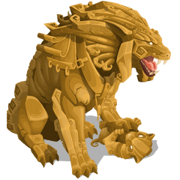

Catch me first.
No, catch ME first.

Slide 74
MONSTER
ITEM
LOOTS
IS_USED_IN
RECIPE
MONSTER
ITEM
CRAFTS
CAN_ATTRACT

Slide 75
MATCH (monster1:MonsterMarketplaceItem)
-[:LOOTS]->(loot)
-[r:IS_USED_IN|CRAFTS*0..]->(bait)
-[:CAN_ATTRACT]->(monster2)
RETURN monster1, monster2

Slide 76


Slide 77

Notes:
So now that we've pretty much modelled the entire game as a graph, it turns out that there are other use cases for this model which we didn't see initially.
For instance, sometime ago we made the tough decision to rewrite the entire season 1 quests,
It was a massive undertaking,
but we felt it was necessary because after running the game for more than a year,
we have learnt a lot about how to make contents that our players enjoy and
our system has become more mature and more features are available so we can make more interesting quests.
We wanted to show new players coming into the game the best we can offer,
to give them a game that is more fun to play,
with a more focused and streamlined storyline
and a greater emphasis on quality over quantity.

Slide 78
LONDON 2.0
WE REWROTE THE ENTIRE SEASON 1
QUESTS TO MAKE THEM BETTER.

Slide 79

TWICE
THE FUN

Slide 80
SEASON 1
SEASON 1
(POST-REWRITE)
SEASON 2

Slide 81
STREAMLINED
MORE

Slide 82
QUALITY >
QUANTITY
Notes:
I think the guys really did the good job in taking the entire season 1 apart and putting them back to make a better experience for our players.
But, the big downside long term, is that you now have twice as much content to support
and really made life much harder for our customer support and QA team,
and ultimately the added cognitive load impacts everyone including the developers and game designers.

Slide 83

TWICE
THE AMOUNT
SUPPORT
TO

Slide 84
Neo4j to the rescue!
Notes:
And one of the things I've been looking at is to build some tooling to solve some of the recurring challenges we face
by making use of this rich graph model that we've captured and make it accessible and useable by others.
Take some common questions that players ask:
which quest comes after the 'Year of the Horse'? Simple, look at the quests that are UNLOCKED by that quest.
- when do I unlock the blueprint for the experts windmill? Again, an easy one, find the quest which AWARDS the blueprint.
and the list goes on and on.
I've been using Neo4j for a while now and I'm continued to be excited and amazed by the ways in which it can help us do things better.
So, kudos to the guys at Neo Tech for this amazing piece of tech.

Slide 85

Thank you!

Slide 86
Here Be Monsters http://www.herebemonstersgame.com http://apps.facebook.com/herebemonsters Building a MMORPG http://bit.ly/1hjqoL8 http://slidesha.re/18MD4XY Google I/O 2013 – Here Be BigQuery http://bit.ly/1fHjbce

Slide 87

WE’RE HIRING
www.gamesyscorporate.com/careers

